Slide 1

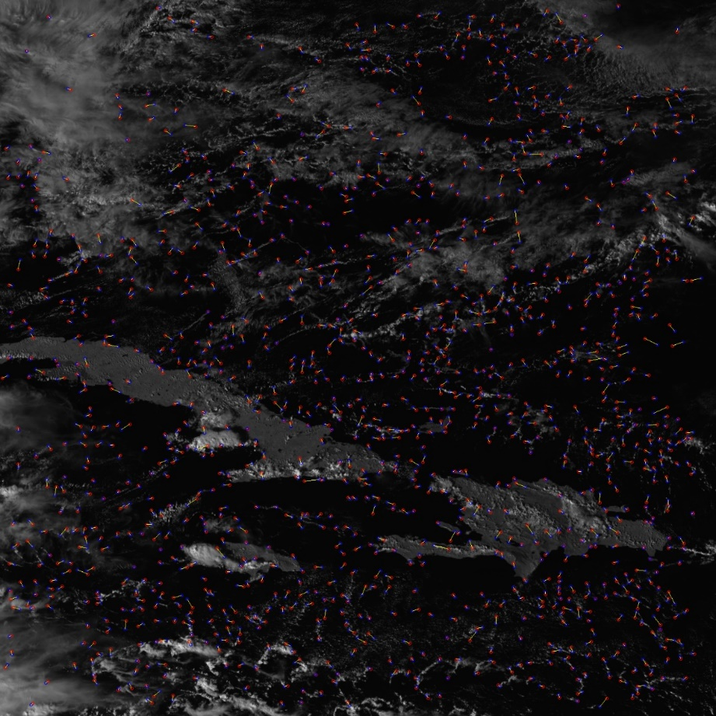
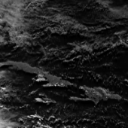
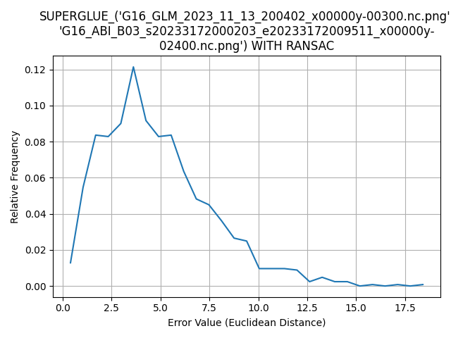
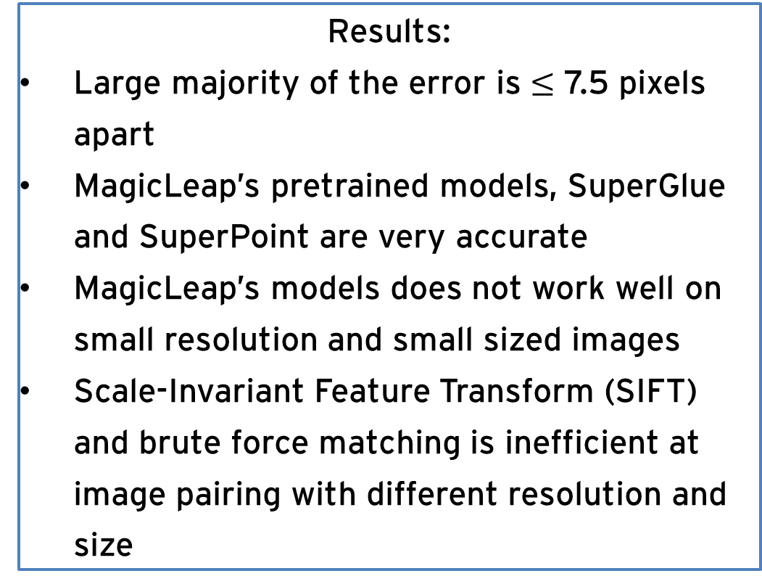
Exploring Satellite Image Registration with AI
By: Jacob Lin
Mentor: Dr. Fangfang Yu
Research Goal:
Use algorithms, machine learning, and/or artificial intelligence to identify key points within sets of images and correctly pair images produced by satellite instruments
Key points are crucial to establish the geometric calibration of the satellite instruments
Figure 2, Image generated by the GLM instrument
Figure 1, Image generated by the ABI instrument, red dots are the key points generated by SuperPoint, blue dots are predicted points
Procedure:
The Advanced Baseline Imager (ABI) and the Geostationary Lightning Mapper (GLM) on the GOES-16 satellite generate images
Resize images
SuperPoint to generate key points within the images
SuperGlue to match the key points of images
Assess the quality of matches using homography based
Distance formula for error
Results:
Large majority of the error is $≤$ 7.5 pixels apart
MagicLeap’s pretrained models, SuperGlue and SuperPoint are very accurate
MagicLeap’s models does not work well on small resolution and small sized images
Scale-Invariant Feature Transform (SIFT) and brute force matching is inefficient at image pairing with different resolution and size
Figure 3, Image of the relative histogram which shows the error value (in pixels) between the predicted and actual key point during the homography assessment.

